Slide 1
ECED3901
Design Methods II
Lecture #2: Design Process
Colin O’Flynn

Slide 2
What are we covering?

Slide 3
Part #1 – Designs

Slide 4
What makes a good product?

Slide 5
Good Design?

Slide 6
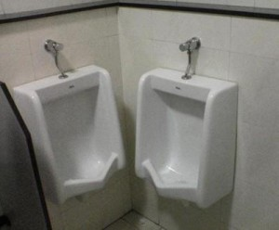
Bad Design?
https://openlab.citytech.cuny.edu/artlife/2014/05/12/bad-design1/

Slide 7
Design Pitfalls

Slide 8
Step 1: Listen to Customers.

Slide 9
Step 2: Ignore Your Customers.

Slide 10
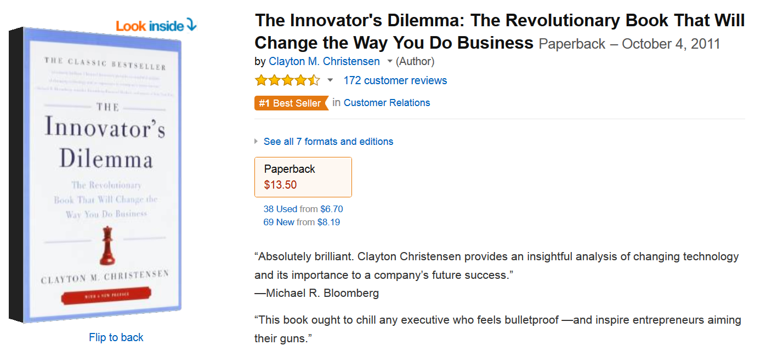
(The Following Loosely Adapted From)
Hype is turned up to 11 so read with caution, but has some interesting material anyway

Slide 11
Product Types: Iterative

Slide 12
Product Types: Disruptive

Slide 13
Examples of Disruptive Products
Wikipedia → Classic Encyclopedia
Telephones → Telegraph
Digital Camera → Film Camera

Slide 14

Timing for Disruptive Products
Example: GPS network turned Selective Availability Off

Slide 15
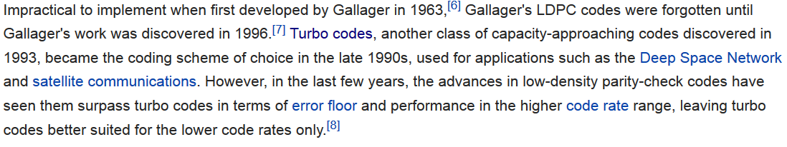
Sidebar: What is a Product?
Source: http://en.wikipedia.org/wiki/Turbo_code and http://en.wikipedia.org/wiki/Low-density_parity-check_code

Slide 16
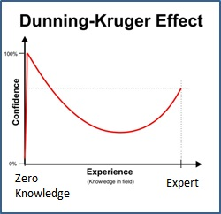
You are Probably Wrong
Dunning–Kruger effect
“Unskilled and Unaware of It: How Difficulties in Recognizing One's Own Incompetence Lead to Inflated Self-Assessments”

Slide 17
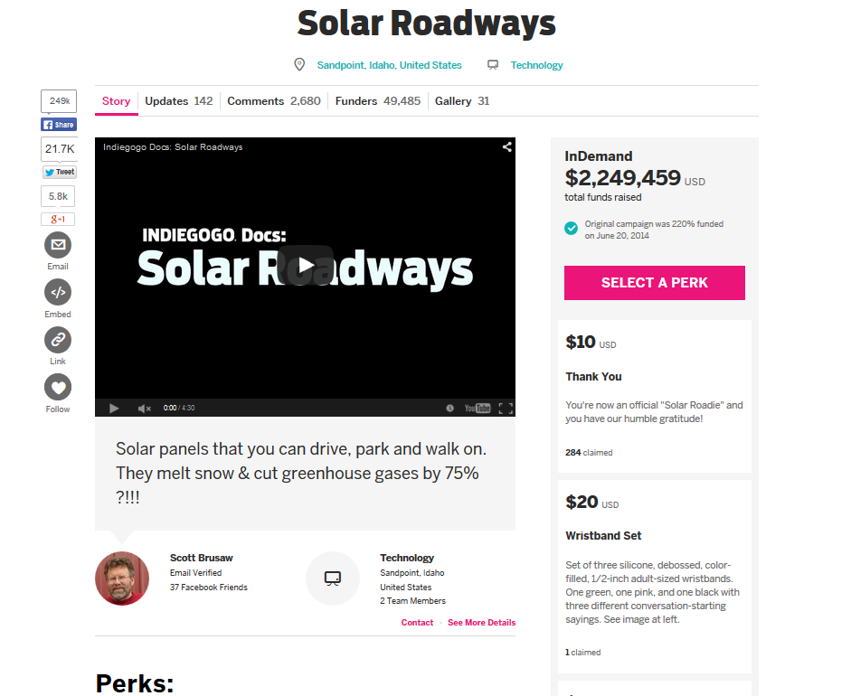
Impossible Products

Slide 18
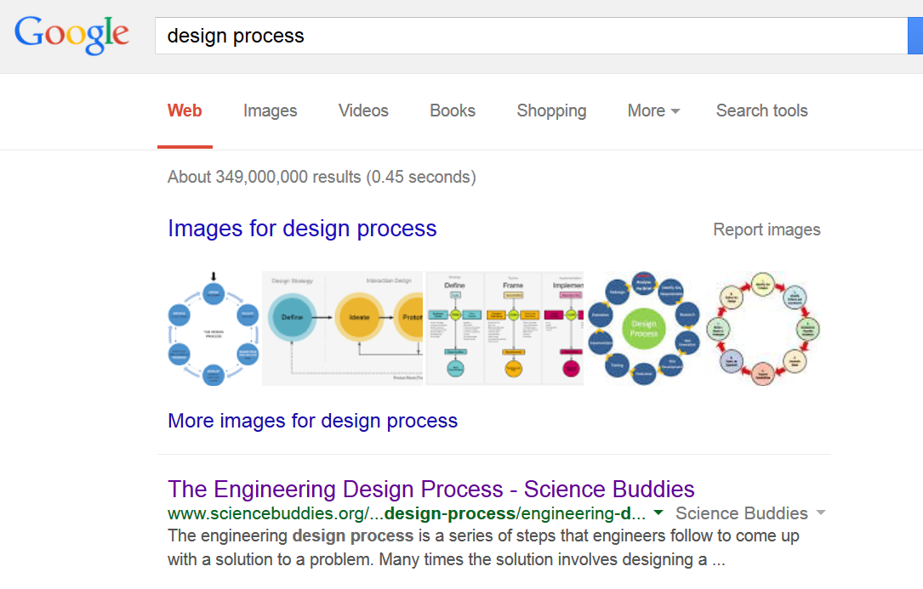
“Design Process”

Slide 19
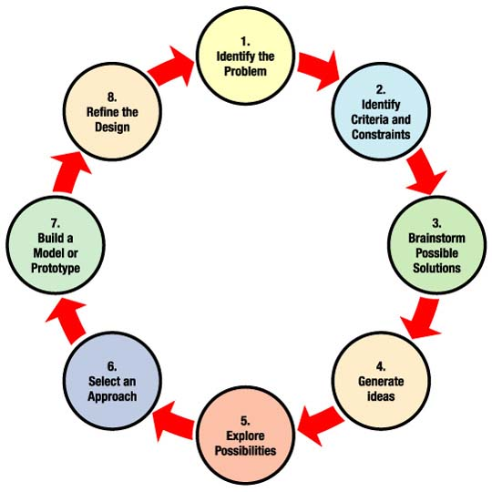
“Design Process”
Source: http://www.nasa.gov/audience/foreducators/plantgrowth/reference/Eng_Design_5-12_prt.htm

Slide 20
Realistic Design Process
Don’t be afraid to iterate frequently
Plan on making many loops – exploring one aspect might require a run through the entire “design process” – that run lasting 45 mins

Slide 21
Design Process
Idea Generation
Conceptual Design
Detailed Design
Prototyping
Refinement / Ramp-Up
Source: http://www.nasa.gov/audience/foreducators/plantgrowth/reference/Eng_Design_5-12_prt.htm

Slide 22
Idea Generation
Problem statement
Scope of solution
Functions Required
Specifications
Constraints (physical, funding, legal)
Approximate Scheduling
Brainstorming

Slide 23
Conceptual Design
Concepts Proposed
Proof-of-Concept Prototypes
Manufacturing Constraints explored
Possible early Customer Feedback

Slide 24
Detailed Design
Electrical design
Mechanical design
Supply-chain validated (i.e. are parts End-of-Life (EOL)?)
Prototyping (again)
Documentation started

Slide 25
Prototyping
‘Real’ prototypes (approaching full-featured)
Possible issues identified, possible variants tested
i.e.: We have choice of four connectors, which is most reliable? Make PCB with each connector, put through testing
Closer discussions with eventual manufacture, Design For Manufacturing (DFM) considerations raised/tested/fixed.
Test/QA plan formalized

Slide 26
Refinement / Ramp-Up
Small production run (if applicable)
Full production run (if applicable)
Finalize specs, datasheet

Slide 27
Part #2 – Design Methods

Slide 28
Stage-Gate Method

Slide 29
Agile Development
Normally used for software development
Holds “Sprints” during which a potential product/version is generated
Sprints are short time-frames (weeks-month)
Customer shown this version, possible feedback if not what they are looking for

Slide 30
SCRUM
See http://www.slideshare.net/jaaronfarr/scrum-agile-for-everyone

Slide 31
Part #3 - Idea Generation

Slide 32
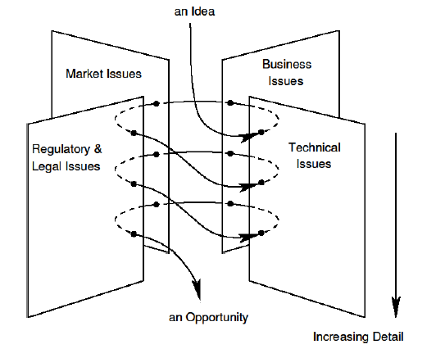
Opportunity Helix

Slide 33
Brainstorming
Focus on quantity
Add unusual / impossible ideas
Combine / improve ideas
Take a break between sessions to mull over ideas!

Slide 34
Proof of Concept Testing (Again)
Use with any of the previous methods…

Slide 35
Summary
Good design achieves the goal, determining what the goal is might be much harder than just asking customers (but where you should start).
Avoid feature creep & desire to use or invent new technologies unless they directly achieve the goal.
Use proof-of-concept (PoC) testing early and often, sometimes before goal has been fully defined.
Disruptive products/innovations often invent entirely new markets or open markets to new customers. They take longer to become profitable (normally) and more likely to fail.

